Slide 1

Course : Data Structures
Subject Code : CSEN2001 Program : B. Tech
Year : II
Dept. and Sec : CSE ( )
UNIT : IV
Dr Kranthi Kumar Singamaneni
Dept. of C.S.E
G.S.T, GITAM Deemed to be University

Slide 2
Trees:
Definitions and properties
Representation of binary trees, operations
Binary tree traversals
Binary search tree
AVL trees, operations
Heap sort

Slide 3

An intuitive introduction to Non-Linear Data Structure
Suppose, John and Sarah are two high school students. Their class teacher assigned them to give a detailed list consisting of the names of the Faculties in their year, along with their departments.
John decides to make a table consisting of the names of each person along with his/her department and designations.
Sarah, on the other hand, decides to make a tree diagram that shows all the faculties along with their designations:
Member Name | Designation
Jane | Principal
Marilla | HOD, Science Dept
Anne | Teacher, Physics
Gilbert | Teacher, Chemistry
Moody | Teacher, Math's
Mathew | HOD, Commerce Dept
Jerry | Teacher, Accountancy
Prissy | Teacher, Business Studies
Mary | Teacher, Economics
Q. Who do you think will get a better grade in their assessment?
It's Sarah because she has represented the relationship between the faculties while John has only provided a one-sided list that does not show who works under whom. John's list is a linear data structure as you might have guessed, while Sarah's tree is a non-linear data structure.

Slide 4
A Non-Linear Data Structure is one in which its elements are not connected in a linear fashion, as suggested by its name itself.
In such a data structure elements might be connected in a hierarchical manner like a tree or graph, or it may be nonhierarchical like in a LinkedList. Non-linear data structures have a more complex implementation than their linear counterparts.
This session introduces Non-Linear Data structure, explores examples of non-linear data structure, and goes through the differences between linear and nonlinear data structures.
The main advantage of non-linear data structure is that it uses memory very efficiently than linear data structures.
Q. Why is LinkedList Non-Linear?
Even though it might seem that LinkedList should be Linear due to its sequential connection of elements, you must remember that there is no contiguous memory structure in a LinkedList. All the elements of a LinkedList are spread across the memory in a Non-Linear fashion, hence it is a Non-Linear Data Structure.
Linear Data Structure | Non-Linear Data Structure
Elements are connected sequentially or in a contiguous manner. | Elements are not connected sequentially or in a contiguous manner.
Elements are always present in a single level | Elements may be present in single or multiple levels.
There is no hierarchy between the elements. | There is usually a hierarchy between elements.
They are easier to implement. | They have a more complex implementation.
Memory allocation is sequential. | Memory allocation isn’t sequential.
Can be traversed in a single run. | Requires multiple runs for traversal.
Inefficient utilization of memory. | Memory is utilized efficiently.
Examples include arrays, hash tables, stack, queue | Examples include trees, graphs etc.
Let us now analyze the key points of a Non-Linear Data Structure:
Elements are not arranged sequentially.
One element can be connected to multiple elements.
There might be a hierarchical structure present.
Here, memory is not allocated in a contiguous manner, unlike linear data structure.
Examples of Non-Linear Data Structure:
Some examples of non-linear data structures are LinkedList, Trees, and Graphs. We'll now go through each of them and understand why they are called nonlinear data structures.

Slide 5
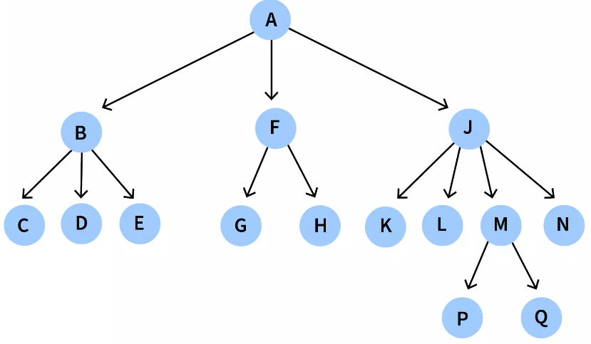
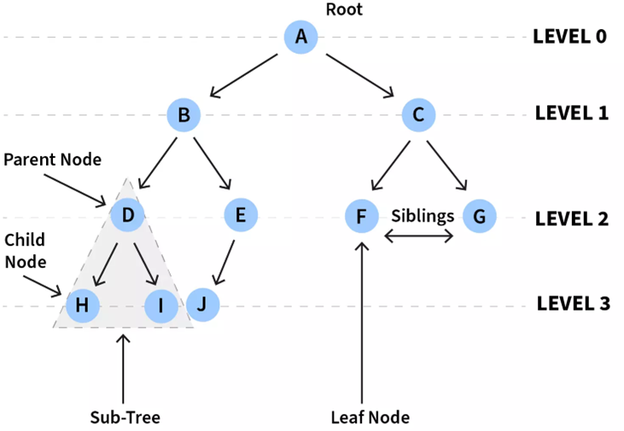
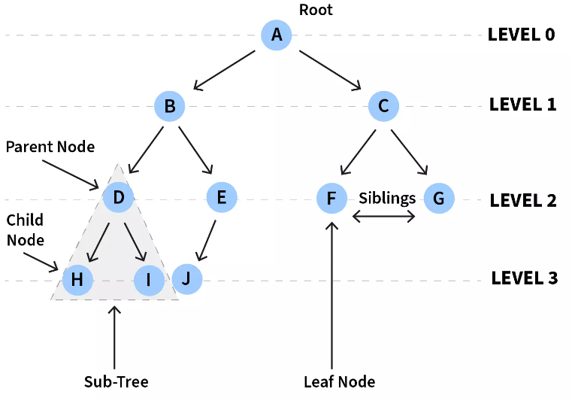
Tree: As you might have figured it, the tree is a data structure that is both nonlinear as well as hierarchical. Here elements are arranged in multiple levels, and each level can be completely or partially filled. Let us now go through some of the basic terminologies of a tree-
Root – The topmost node of the tree
Parent – Each node is a parent of the nodes connected to it, below.
Child – Each node that is a descendant of another node is called a child of that node.
Siblings – Nodes with the same parent
Leaf - The nodes in the last/bottom-most level of the tree
Edge - Link connecting two nodes.
General Tree: A tree that can contain any number of subtrees is known as a general tree.
Binary Tree: A tree where each node has atmost two children (known as left child and right child) is known as a binary tree. In the figure below, each subtree has either one or two child.
We will now see the types of trees out there:

Slide 6
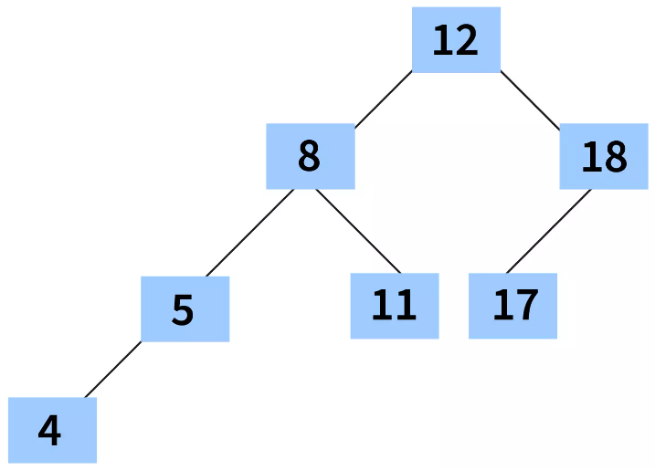
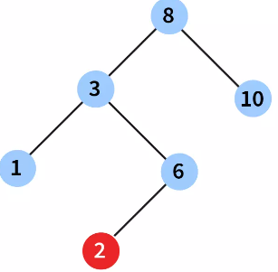
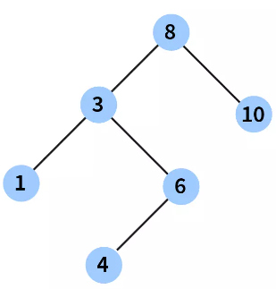


Binary Search Tree: A binary Search tree is a special kind of binary tree that holds the following properties:
All the nodes in the left subtree hold key with a value lesser than the node's key value.
All the nodes in the right subtree hold key with a value greater than the node's key value.
The first figure is a Binary Search Tree since it holds the above two properties.
However, for the second figure, 2 lies in the right subtree of 3 and has a lesser value than 3, whereas, in a Binary Search Tree, all the nodes in the right subtree should hold a key with a value greater than the node's key value. Hence, the second figure is not a Binary Search Tree.
AVL Tree: AVL Tree is a special kind of Binary Search Tree where the height difference of the left and right subtrees is less than or equal to one. Eg - In the figure given below, let’s analyze height difference of the left and right subtrees for all the subtrees:
Parent Node of Subtree | Height of left subtree | Height of right subtree | Height difference
12 | 3 | 2 | 1
8 | 2 | 1 | 1
18 | 1 | 0 | 1
5 | 1 | 0 | 1
11 | 0 | 0 | 0
17 | 0 | 0 | 0
4 | 0 | 0 | 0
As, we can see, the maximum height difference between any left and right subtree is one. Thus the below tree is an AVL Tree.

Slide 7
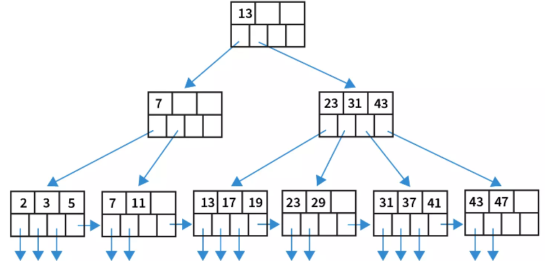
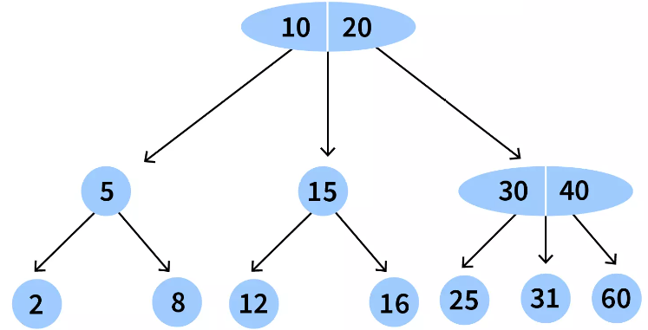
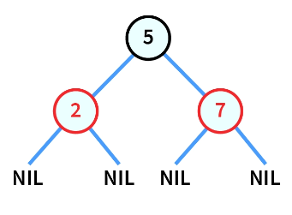
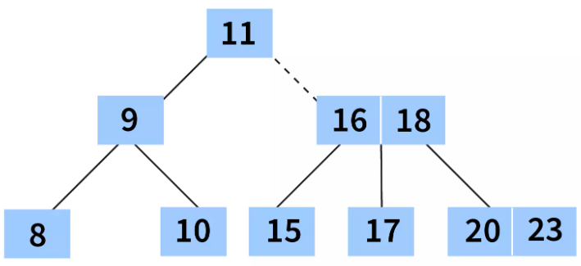
2-3 Tree: A tree where every non leaf node has either of the following two properties:
One data element and two children.
Two data elements and three children.
B+ Tree: B+ tree is an extension of B Tree. It often contains large number of children per node.
B Tree: A B Tree helps to store data in sorted order and is commonly used in database or file systems. Below are some of the properties that a B Tree of order m holds:
There can be atmost m children for each node.
There should be atleast ⌈m/2⌉ child nodes for each non-leaf node (except root).
The root should contain minimum 1 key.
Depth of every leaf is same.
Red Black Tree: Red-black trees are self-balancing binary search trees where each node has one extra attribute which denotes its color (either RED or BLACK). Nodes are colored to ensure that the height of the tree remains balanced after insertion or deletion from it.

Slide 8
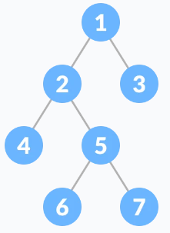
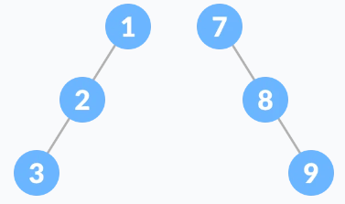
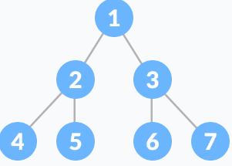
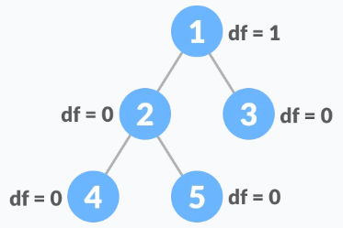
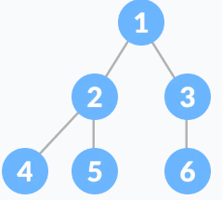
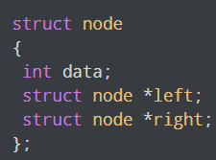
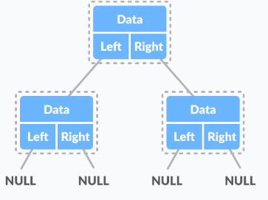
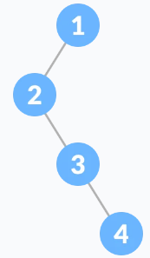
Types of binary trees
5. Skewed Binary Tree: A skewed binary tree is a pathological/degenerate tree in which the tree is either dominated by the left nodes or the right nodes. Thus, there are two types of skewed binary tree: left-skewed binary tree and right-skewed binary tree.
1. Full Binary Tree: A full Binary tree is a special type of binary tree in which every parent node/internal node has either two or no children.
2. Perfect Binary Tree: A perfect binary tree is a type of binary tree in which every internal node has exactly two child nodes and all the leaf nodes are at the same level.
6. Balanced Binary Tree: It is a type of binary tree in which the difference between the height of the left and the right subtree for each node is either 0 or 1.
3. Complete Binary Tree: It is a special type of binary tree where all the levels of the tree are filled completely except the lowest level nodes which are filled from as left as possible.
Binary Tree Representation: A node of a binary tree is represented by a structure containing a data part and two pointers to other structures of the same type.
4. Degenerate/Pathological Tree
A degenerate or pathological tree is the tree having a single child either left or right.

Slide 9
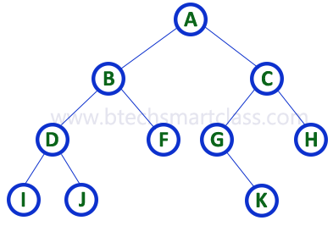
Representation of binary trees
How to identify the left child, right child, and parent of any node that is represented in the sequential form?
In instance 1
If a node is at the i^{th} index the
The left child would be at (2*i)+1
The right child would be at (2*i+2)
The parent would be the floor((i-1)/2)
In instance 2
If a node is at the i^{th} index the
The left child would be at (2*i)+
The right child would be at (2*i+1)
The parent would be the floor(i/2)
The Binary tree means the node can have a maximum of two children. Here, the binary name suggests that ‘two’; therefore, each node can have either 0, 1, or 2 children. A binary tree data structure is represented using two methods. Those methods are as follows...
Array Representation
Linked List Representation
Consider the given binary tree...
1. Array Representation of Binary Tree
In the array representation of a binary tree, we use a one-dimensional array (1-D Array) to represent a binary tree. Consider the above example of a binary tree, and it is represented as follows...
To represent a binary tree of depth 'n' using array representation, we need a one-dimensional array with a maximum size of 2n + 1.
0 1 2 3 4 5 6 7 8 9 10 11 12 13 14 15 16 17 18 19 20
1 2 3 4 5 6 7 8 9 10 11 12 13 14 15 16 17 18 19 20 21

Slide 10

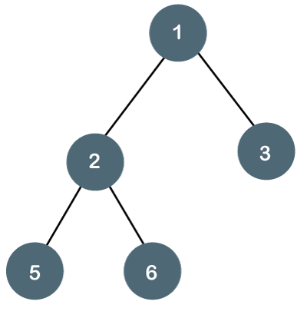
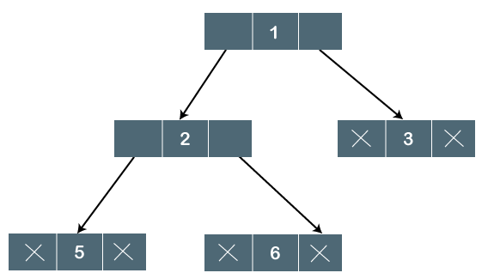
2. Linked List Representation of Binary Tree
We use a double-linked list to represent a binary tree. In a double-linked list, every node consists of three fields. The first field is for storing the left child address, the second for storing actual data, and the third for storing the right child address.
In this linked list representation, a node has the following structure...
The general form of the left binary tree picture is represented using Linked list in the right-side picture.
Properties of Binary Tree
At each level of i, the maximum number of nodes is 2^{i}.
The tree’s height is defined as the longest path from the root node to the leaf node. The tree which is shown above has a height equal to 3. Therefore, the maximum number of nodes at height 3 equals (1+2+4) = 7.
Generally, the maximum number of nodes possible at height h is (2⁰ + 2¹ + 2²+….2^{h}) = 2^{h+1} -1.
The minimum number of nodes possible at height h equals h+1.
If there are 'n' number of nodes in the binary tree.
The minimum height can be computed as follows: As we know,
n = 2^{h+1} -1
n+1 = 2^{h+1}
Taking logs on both sides,
log₂(n+1) = log₂ (2^{h+1})
log₂(n+1) = h+1
h = log₂ (n+1) - 1
The maximum height can be computed as: As we know,
n = h+1
h= n-1

Slide 11
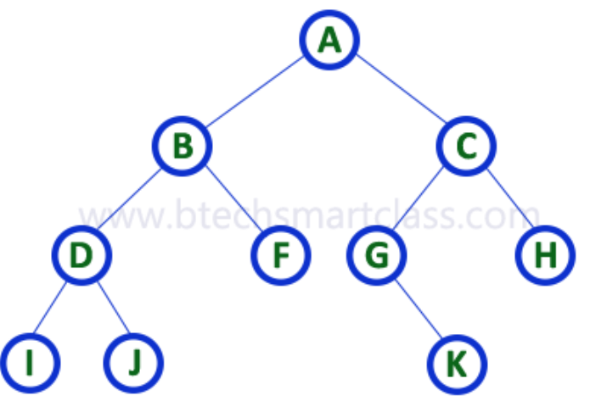
Binary tree operations traversals
In-Order Traversal ( left child- root – right child)
In In-Order traversal, the root node is visited between the left child and the right child. In this traversal, the left child node is visited first, then the root node is visited, and later, we go for visiting the right child node. This in-order traversal is applicable for every root node of all subtrees in the tree. This is performed recursively for all nodes in the tree.
The main operations in a binary tree are: search, insert and delete. When we wanted to display a binary tree, we need to follow some order in which all the nodes of that binary tree must be displayed. In any binary tree, displaying order of nodes depends on the traversal method.
Displaying (or) visiting order of nodes in a binary tree is called as Binary Tree Traversal.
There are three types of binary tree traversals.
In - Order Traversal
Pre - Order Traversal
Post - Order Traversal
Consider the following binary tree...
In the above example of a binary tree, first, we try to visit the left child of root node ‘A’, but A’s left child ‘B’ is a root node for the left subtree. So we try to visit its (B’s) left child ‘D’, and again D is a root for subtree with nodes D, I, and J. So we try to visit its left child, 'I', and it is the leftmost child. So first we visit 'I’ , then go for its root node 'D' and later we visit D's right child 'J'. With this, we have completed the left part of node B. Then visit 'B’, and next B's right child 'F' is visited. With this, we have completed the left part of node A. Then visit root node 'A'. With this, we have completed the left and root parts of node A. Then we go for the right part of node A. In the right of A again, there is a subtree with root C. So go for a left child of C, and again it is a subtree with root G., But G does not have a left part, so we visit ’G’ and then visit G’s right child K. With this, we have completed the left part of node C. Then visit root node 'C' and next visit C's right child 'H' which is the rightmost child in the tree. So we stop the process.
That means here we have visited in the order of I - D - J - B - F - A - G - K - C - H
using In-Order Traversal

Slide 12
2. Pre - Order Traversal ( root – left child – right child )
In Pre-Order traversal, the root node is visited before the left child and right child nodes. In this traversal, the root node is visited first, then its left child and later its right child. This pre-order traversal is applicable for every root node of all subtrees in the tree.
In the above example of a binary tree, first, we visit root node 'A' then visit its left child 'B' which is a root for D and F. So we visit B's left child 'D’, and again D is a root for I and J. So we visit D’s left child, ’I’ which is the leftmost child. So next, we go to visit D’s right child ’J’. With this, we have completed the root, left, and right parts of node D and the root, and left parts of node B. Next, visit B’s right child ’F’. With this, we have completed the root and left parts of node A.
So we go for A's right child 'C' which is a root node for G and H. After visiting C, we go for its left child 'G' which is a root for node K. So next, we visit the left of G, but it does not have the left child, so we go for G’s right child, ’K’. With this, we have completed node C’s root and left parts. Next, visit C's right child 'H' which is the rightmost child in the tree. So we stop the process.
That means here we have visited in the order of A-B-D-I-J-F-C-G-K-H using Pre-Order Traversal.
3. Post - Order Traversal ( left child – right child – root )
In Post-Order traversal, the root node is visited after the left child and right child. In this traversal, the left child node is visited first, then its right child, and then its root node. This is recursively performed until the rightmost node is visited.
Here we have visited in the order of I - J - D - F - B - K - G - H - C - A using Post-Order Traversal.

Slide 13
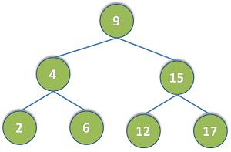
C Binary search Tree with an Example C Code (Search, Delete, Insert Nodes)
Binary tree is the data structure to maintain data into memory of program. There exists many data structures, but they are chosen for usage on the basis of time consumed in insert/search/delete operations performed on data structures.
Binary tree is one of the data structures that are efficient in insertion and searching operations. Binary tree works on O (logN) for insert/search/delete operations.
Binary tree is basically tree in which each node can have two child nodes and each child node can itself be a small binary tree. To understand it, below is the example figure of binary tree.
Binary tree works on the rule that child nodes which are lesser than root node keep on the left side and child nodes which are greater than root node keep on the right side. Same rule is followed in child nodes as well that are itself sub-trees. Like in above figure, nodes (2, 4, 6) are on left side of root node (9) and nodes (12, 15, 17) are on right side of root node (9).

Slide 14
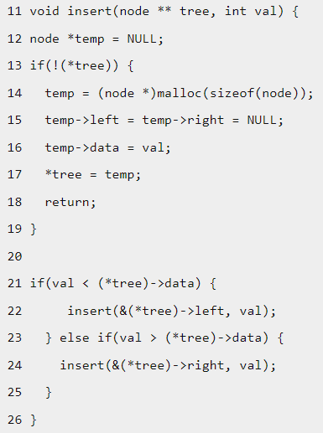
We will understand binary tree through its operations. We will cover following operations.
Create binary tree
Search into binary tree
Delete binary tree
Displaying binary tree
Creation of binary tree: Binary tree is created by inserting root node and its child nodes. We will use a C programming language for all the examples. Below is the code snippet for insert function. It will insert nodes.
This function would determine the position as per value of node to be added and new node would be added into binary tree. Function is explained in steps below and code snippet lines are mapped to explanation steps given below.
[Lines 13-19] Check first if tree is empty, then insert node as root.
[Line 21] Check if node value to be inserted is lesser than root node value, then
a. [Line 22] Call insert() function recursively while there is non-NULL left node
b. [Lines 13-19] When reached to leftmost node as NULL, insert new node.
[Line 23] Check if node value to be inserted is greater than root node value, then
a. [Line 24] Call insert() function recursively while there is non-NULL right node
b. [Lines 13-19] When reached to rightmost node as NULL, insert new node.

Slide 15
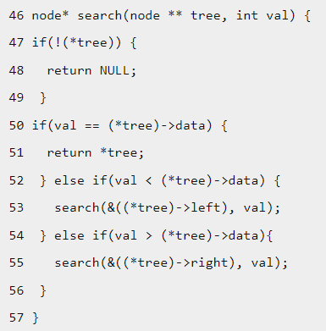
Searching into binary tree: Searching is done as per value of node to be searched whether it is root node or it lies in left or right sub-tree. Below is the code snippet for search function. It will search node into binary tree.
This search function would search for value of node whether node of same value already exists in binary tree or not. If it is found, then searched node is returned otherwise NULL (i.e. no node) is returned. Function is explained in steps below and code snippet lines are mapped to explanation steps given below.
[Lines 47-49] Check first if tree is empty, then return NULL.
[Lines 50-51] Check if node value to be searched is equal to root node value, then return node
[Lines 52-53] Check if node value to be searched is lesser than root node value, then call search() function recursively with left node
[Lines 54-55] Check if node value to be searched is greater than root node value, then call search() function recursively with right node
Repeat step 2, 3, 4 for each recursion call of this search function until node to be searched is found.

Slide 16
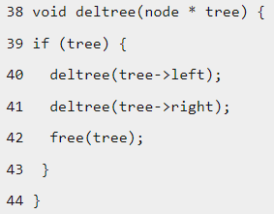
Deletion of binary tree: Binary tree is deleted by removing its child nodes and root node. Below is the code snippet for deletion of binary tree.
This function would delete all nodes of binary tree in the manner – left node, right node and root node. Function is explained in steps below and code snippet lines are mapped to explanation steps given below.
[Line 39] Check first if root node is non-NULL, then
a. [Line 40] Call deltree() function recursively while there is non-NULL left node
b. [Line 41] Call deltree() function recursively while there is non-NULL right node
c. [Line 42] Delete the node.

Slide 17
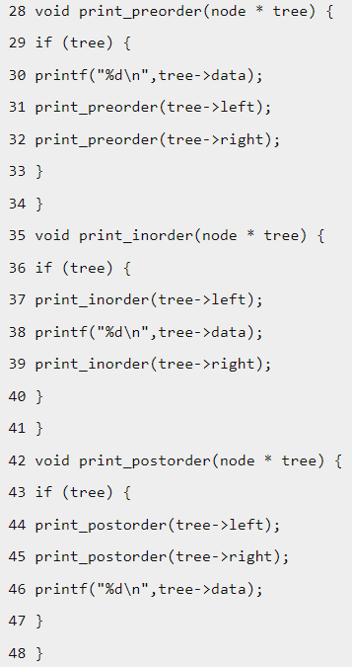
Displaying binary tree: Binary tree can be displayed in three forms – pre-order, in-order and post-order.
Pre-order displays root node, left node and then right node.
In-order displays left node, root node and then right node.
Post-order displays left node, right node and then root node.
These functions would display binary tree in pre-order, in-order and post-order respectively. Function is explained in steps below and code snippet lines are mapped to explanation steps given below.
Pre-order display
a. [Line 30] Display value of root node.
b. [Line 31] Call print_preorder() function recursively while there is non-NULL left node
c. [Line 32] Call print_preorder() function recursively while there is non-NULL right node
In-order display
a. [Line 37]Call print_inorder() function recursively while there is non-NULL left node
b. [Line38] Display value of root node.
c. [Line 39] Call print_inorder() function recursively while there is non-NULL right node
Post-order display
a. [Line 44] Call print_postorder() function recursively while there is non-NULL left node
b. [Line 45] Call print_postorder() function recursively while there is non-NULL right node
c. [Line46] Display value of root node.

Slide 18
Working program: It is noted that above code snippets are parts of below C program. This below program would be working basic program for binary tree.
#include<stdlib.h>#include<stdio.h>
struct bin_tree
{
int data;
struct bin_tree * right, * left;
};
typedef struct bin_tree node;
void insert(node ** tree, int val)
{
node *temp = NULL;
if(!(*tree))
{
temp = (node *)malloc(sizeof(node));
temp->left = temp->right = NULL;
temp->data = val;
*tree = temp; return;
}
if(val < (*tree)->data)
{
insert(&(*tree)->left, val);
}
else if(val > (*tree)->data)
{
insert(&(*tree)->right, val);
}
}
void print_preorder(node * tree)
{
if (tree)
{
printf("%d\n",tree->data);
print_preorder(tree->left);
print_preorder(tree->right);
}
}
void print_inorder(node * tree)
{
if (tree)
{
print_inorder(tree->left);
printf("%d\n",tree->data);
print_inorder(tree->right);
}
}
void print_postorder(node * tree)
{
if (tree)
{
print_postorder(tree->left);
print_postorder(tree->right);
printf("%d\n",tree->data);
}
}
void deltree(node * tree)
{
if (tree)
{
deltree(tree->left);
deltree(tree->right);
free(tree);
}
}
node* search(node ** tree, int val)
{
if(!(*tree))
{
return NULL;
}
if(val < (*tree)->data)
{
search(&((*tree)->left), val);
}
else if(val > (*tree)->data)
{
search(&((*tree)->right), val);
}
else if(val == (*tree)->data)
{
return *tree;
}
}

Slide 19
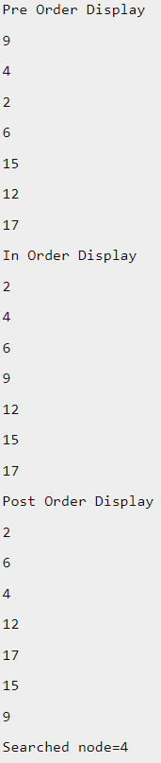
void main()
{
node *root; node *tmp; root = NULL;
/* Inserting nodes into tree */
insert(&root, 9);
insert(&root, 4);
insert(&root, 15);
insert(&root, 6);
insert(&root, 12);
insert(&root, 17);
insert(&root, 2);
/* Printing nodes of tree */
printf("Pre Order Display\n"); print_preorder(root);
printf("In Order Display\n");
print_inorder(root);
printf("Post Order Display\n");
print_postorder(root);
/* Search node into tree */
tmp = search(&root, 4);
if (tmp)
{ printf("Searched node=%d\n", tmp->data); }
else
{ printf("Data Not found in tree.\n"); }
/* Deleting all nodes of tree */
deltree(root); }
Output of Program: It is noted that binary tree figure used at top of article can be referred to under output of program and display of binary tree in pre-order, in-order and post-order forms.

Slide 20
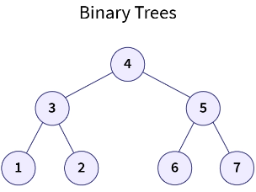
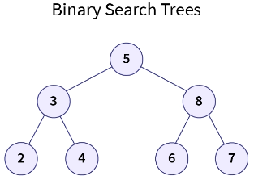
AVL tree and operations: (Adelson-Velsky and Landis) Tree is a self-balancing binary search tree that can perform certain operations in logarithmic time. It exhibits height-balancing property by associating each tree node with a balance factor and ensuring that it stays between -1 and 1 by performing specific tree rotations. This property prevents the Binary Search Tree from getting skewed, achieving a minimal height tree that provides logarithmic time complexity for some significant operations such as searching.
Introduction: In our fast-paced daily lives, we make use of a lot of different data structures and algorithms without even noticing them. For example, consider a scenario in which you wish to call someone from your contact list that contains a ton of data. You need to find that individual’s phone number by searching. This is internally implemented using specific data structures and uses particular algorithms to provide you with the best results in an efficient manner. This is required as the faster the search, the more convenience you get, and the faster you can connect with others.
With time, this search process was gradually improved by implementing and developing new data structures that eradicate or reduce the limitations of the previously used methods. One such data structure is AVL Trees. It was developed to reduce the limitations of the searching process implemented using a non-linear data structure known as Binary Search Trees.
Now, you may ask what exactly the limitation was and how AVL Trees overcame it, providing us with a better search process in terms of efficiency. For this, let’s take a look at the Binary Search Trees (BSTs) search process, its limitations, and how the AVL Trees overcome them.
Searching Using Binary Search Trees: A Tree is a non-linear and hierarchical data structure that consists of a root node (the topmost node of the tree), and each node can have some number of children nodes. It represents an actual hierarchical tree structure, such as your Family Tree. Now, a special case of trees is the Binary Trees, i.e., trees in which every node has at most two children. Furthermore, Binary Search Trees are a special type of binary tree in which all the elements in the left subtree of a node are smaller than that node, whereas all the elements in the right subtree are greater in value (BST Rule).
In the above example, you can notice that all the nodes of the Binary Search Tree follow the BST rule i.e., for all the nodes, their left subtrees have lesser values while the right subtrees have more significant values.

Slide 21
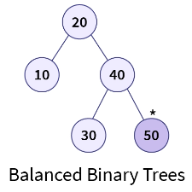
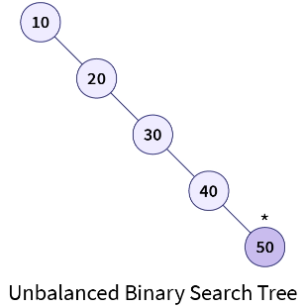
Binary Search Trees are useful in searching for an element from a constantly updating data stream or in finding an element when a combination of search and update operations are being performed on a dataset.
Here, upon each updation in the data stream, the element is inserted in the BST, and the search is performed based on the query provided. In BSTs, to find an element, we start with the root node and check whether the given element is greater than the root node; if it’s greater, we continue searching in the right subtree; otherwise, we look in the left subtree. This process is continued until we find a node with the same value as the given query value or we reach the leaf node of the tree, i.e., the element is not present in the tree. In either case, the tree’s depth or height (the number of edges on the longest path from the root node to a leaf node) defines the time complexity of the search operation.
Let’s understand this effect of height on the searching operation in BSTs with an example:
Now, if we wish to search whether the element 50 is present in this BST, we will have to traverse all the elements present in the BST as 50 is present at the deepest level of the tree. Also, there is no left subtree to traverse at each level. Hence, instead of reducing the number of checks at each level, we are just searching the element in linear time i.e., O(n), where n is the total number of nodes present in the BST.
Case 2: Balanced BST: Now, consider another example in which the same elements are inserted differently, such as [20, 10, 40, 30, 50]. In this case, when we create a BST using this order, it will attain minimal height and will look like this:
Case 1: Unbalanced BST: Consider a sorted array A having elements [10, 20, 30, 40, 50]. Now, when we create a BST for this array, all the elements will be inserted in the right subtree as all have greater value than the previous element, i.e., the BST becomes skewed or unbalanced (for a given node, one subtree is significantly larger than its sibling subtree) and will look like this:
Now, on searching the element 50 in this tree we are reducing the number of comparisons as in each step we are neglecting the left subtrees at each level i.e., we are reducing the check operations by half at each level. Hence, in this case, when the tree is not skewed, the process of searching takes logarithmic time i.e., O (log n) where n is the total number of nodes present in the tree.

Slide 22
In the above example, we can observe that when the tree was skewed in the First case, it attained the maximum height, i.e., O (n), which is the same as the time complexity for the search operation. Also, in the second case, when the tree attained minimal height, i.e., O (log n), the search operation took logarithmic time. Hence, we can say that the height or the depth of the tree somewhat determines the time complexity of the BST.
Now, you may wonder that for the same elements, we can have two Binary Search Trees having drastically different heights and search times. Hence, there must be a way to control the height of the BST such that we always achieve logarithmic search time complexity irrespective of the order of the elements. This can be achieved by checking when the Binary Search Tree starts becoming skewed (Balancing Criteria) and performing certain operations to limit this skewness. This way, we can control the tree’s height and achieve a logarithmic time complexity for almost all the operations. This is exactly where AVL Trees come into action.
Highlights:
BSTs are binary trees in which all elements in the left subtree of a node are smaller while the elements in the right subtree are larger than that node.
BSTs are useful for performing searches on dynamic datasets.
As the operations performed using BSTs always start from the root and traverse down the tree, the time complexity of BSTs depends upon the tree’s height.
BSTs can be skewed (unbalanced) or balanced depending upon the order of insertion of the elements.
Balanced BSTs provide logarithmic time complexity because of their optimal height.

Slide 23
What is an AVL Tree?: AVL Tree, named after its inventors Adelson-Velsky and Landis, is a special variation of Binary Search Tree which exhibits self-balancing property, i.e., AVL Trees automatically attain the minimal possible height of the tree after the execution of any operation. The AVL Trees implement the self-balancing property by attaching extra information known as the balance factor to each node of the tree, then verifying that the balance factor for all the nodes of the tree follows certain criteria (Balancing Criteria) upon the execution of any operation that affects the height of the tree, and finally applying certain Tree Rotations to maintain this criterion of height-balancing.
The Criterion of height balancing is a principle that determines whether a Binary Search Tree is unbalanced (skewed). It states that:
Tip: A Binary Search Tree is considered to be balanced if any two sibling subtrees present in the tree don’t differ in height by more than one level, i.e., the difference between the height of the left subtree and the height of the right subtree for all the nodes of the tree should not exceed unity. If it exceeds unity, then the tree is known as an unbalanced tree.
Since skewed or unbalanced BSTs provide inefficient search operations, AVL Trees prevent unbalancing by defining a balance factor for each node. Let's look at what exactly is this balancing factor.
Highlights:
AVL Trees were developed to achieve logarithmic time complexity in BSTs irrespective of the order in which the elements were inserted.
AVL Tree implemented a Balancing Criteria (For all nodes, the subtrees’ height difference should be at most 1) to overcome the limitations of BST.
It maintains its height by performing rotations whenever the balance factor of a node violates the Balancing Criteria. As a result, it has self-balancing properties.
It exists as a balanced BST at all times, providing logarithmic time complexity for operations such as searching.

Slide 24
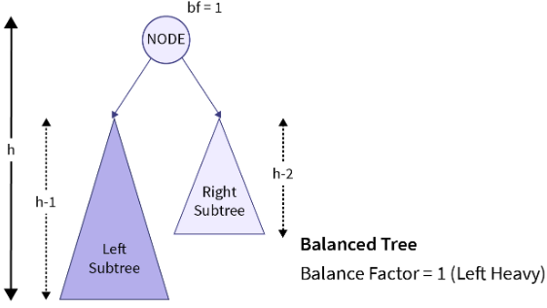
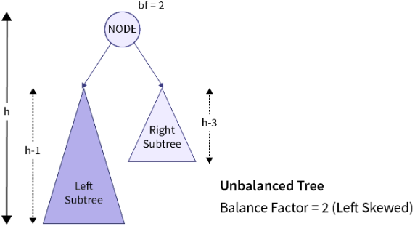
Balance Factor: The balance factor in AVL Trees is an additional value associated with each tree node that represents the height difference between the left and the right sub-trees of a given node. The balance factor of a given node can be represented as:
balance_factor = (Height of Left sub-tree) - (Height of right sub-tree)
Or mathematically speaking, bf=h_{l} −h_{r​}
Where bf is the balance factor of a given node in the tree, h_{l} represents the height of the left subtree, and h_{r} represents the height of the right subtree.
In the balanced tree example of the above illustration, we can observe that the height of the left subtree (h-1) is one greater than the height of the right subtree (h-2) of the highlighted node i.e., the given node is left-heavy having the balance factor of positive unity. Since the balance factor of the node follows the Balancing Criteria (height difference should be at most unity), the given tree example is considered as a balanced tree.
Now, in the unbalanced tree example, we can observe that the tree is left-skewed i.e., the height of the left subtree is much greater than that on the right subtree. This is clearly an unbalanced tree as it is highly skewed. This is also indicated by the balance factor of the node as it doesn’t follow the Balancing Criteria.
Hence, AVL Trees make use of the balance factor to check whether a given node is left-heavy (height of left sub-tree is one greater than that of right sub-tree), balanced, or right-heavy (height of right sub-tree is one greater than that of left sub-tree). Hence, using the balance factor, we can find an unbalanced node in the tree and can locate where the height-affecting operation was performed that caused the imbalance of the tree.

Slide 25
NOTE: Since the leaf nodes don't contain any subtrees, the balance factor for all the leaf nodes present in the Binary Search Tree is equal to 0.
Upon the execution of any height-affecting operation on the tree, if the magnitude of the balance factor of a given node exceeds unity, the specified node is said to be unbalanced as per the Balancing Criteria. This condition can be mathematically represented with the help of the given equation:
bf=(hl​−hr​),s.t.bf∈[−1,0,1] Or ∣bf∣=∣hl​−hr​∣≤1
Here, the above equation indicates that the balance factor of any given node can only take the value of -1, 0, and 1 for a height-balanced Binary Search Tree. To maintain this criterion for all the nodes, AVL Trees take use of certain Tree Rotations that are discussed later in this article.
Highlights:
Balance Factor represents the height difference between a given node’s left and right sub-trees.
For leaf nodes, the balance factor is 0.
AVL balance criteria: |bf| ≤ 1 for all nodes.
Balance factor indicates whether a node is left heavy, right heavy, or balanced.

Slide 26
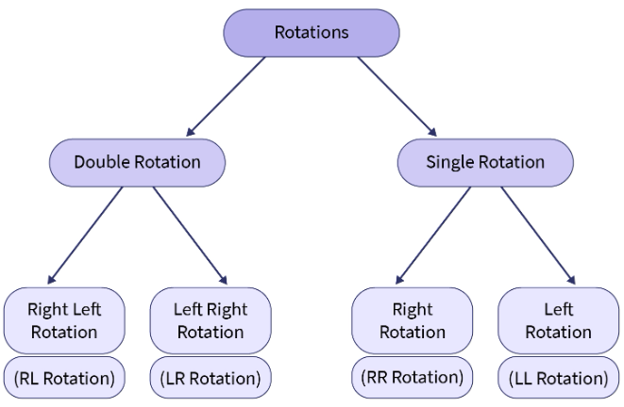
AVL Tree Rotation: As discussed earlier, the AVL Trees make use of the balance factor to check whether a given node is left-heavy (height of left sub-tree is one greater than that of right sub-tree), balanced, or right-heavy (height of right sub-tree is one greater than that of left sub-tree). If any node is unbalanced, it performs certain Tree Rotations to re-balance the tree.
Tree Rotations: It is the process of changing the tree’s structure by moving smaller subtrees down and larger subtrees up, without interfering with the order of the elements.
If the balance factor of any node doesn't follow the AVL Balancing criterion, the AVL Trees make use of 4 different types of Tree rotations to re-balance themselves. These rotations are classified based on the node imbalance cured by them i.e., a specific rotation is applied to counter the change that occurred in the balance factor of a node making it unbalanced.
These rotations include:

Slide 27
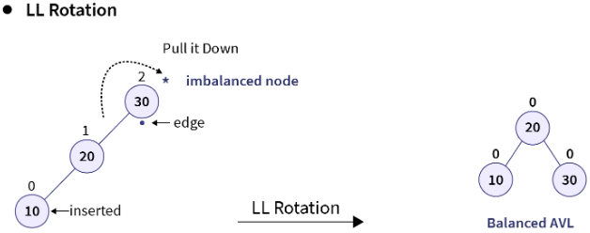
Now, let's look at all the tree rotations and understand how they can balance the tree and make it follow the AVL balance criterion.
1. LL Rotation: It is a type of single rotation that is performed when the tree gets unbalanced upon insertion of a node into the left subtree of the left child of the imbalance node i.e., upon Left-Left (LL) insertion. This imbalance indicates that the tree is heavy on the left side. Hence, a right rotation (or clockwise rotation) is applied such that this left heaviness imbalance is countered and the tree becomes a balanced tree. Let’s understand this process using an example:
Consider a case when we wish to create a BST using elements 30, 20, and 10. Now, since these elements are given in sorted order, the BST so formed is a left-skewed tree as shown below:
This is confirmed after calculating the balance factor of all the nodes present in the tree. As you can observe, when we insert element 10 in the tree, the root node becomes imbalanced (balance factor = 2) because the tree becomes left-skewed upon this operation. Also, notice that element 10 is inserted as a left child in the left subtree of the imbalanced node (here, the root node of the tree). Hence, this is the case of L-L insertion and we will have to perform a certain operation to counter-act this left skewness.
Imagine a weighing scale in which we only have 5 kg on the left plate and nothing on the right plate. This is the case of left heavy since there is nothing on the right plate to balance the weight present in the left plate. Now, to balance this scale we can just add some weight to the right plate. Hence, to balance the weight on one side we try to increase the weight on the other side. In the case of trees, instead of adding a new node (weight) on the lighter side, we try to rotate the structure of the tree around a pivot point thereby shifting the nodes from the heavier side to the lighter side.
In our example, we have extra weight on the left subtree (LL insertion) therefore we will perform right rotation or clockwise rotation on the imbalanced node to transfer this node on the right side to retrieve a balanced tree i.e., we will pull the imbalanced node down by rotating the tree in a clockwise direction along the edge of the imbalanced or in this case, the root node.

Slide 28
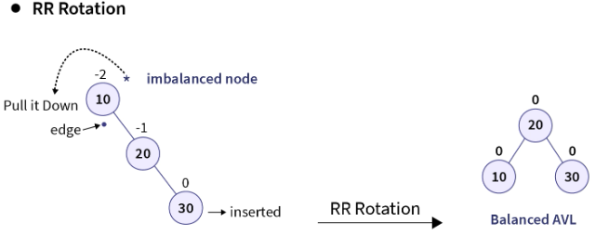
2. RR Rotation: It is similar to that of LL Rotation but in this case, the tree gets unbalanced, upon insertion of a node into the right subtree of the right child of the imbalance node i.e., upon Right-Right (RR) insertion instead of the LL insertion. In this case, the tree becomes right heavy and a left rotation (or anti-clockwise rotation) is performed along the edge of the imbalanced node to counter this right skewness caused by the insertion operation. Let’s understand this process with an example: Consider a case where we wish to create a BST using the elements 10, 20, and 30. Now, since the elements are given in sorted order, the BST so created becomes right-skewed as shown below:
Upon calculating the balance factor of all the nodes, we can confirm that the root node of the tree is imbalanced (balance factor = 2) when the element 30 is inserted using RR-insertion. Hence, the tree is heavier on the right side and we can balance it by transferring the imbalanced node on the left side by applying an anti-clockwise rotation around the edge (pivot point) of the imbalanced node or in this case, the root node.
3. LR Rotation: So far, we have discussed that when the tree is heavy on one side, perform a single rotation in the opposite direction to counter the effect of tree skewness. But, there also exist some cases where a single tree rotation isn’t enough to balance the tree, i.e., we may need to perform one more rotation to counter the height-affecting operation’s effects finally.
One such case is of Left-Right (LR) insertion, i.e.; the tree gets unbalanced upon insertion of a node into the right subtree of the left child of the imbalance node. Let’s understand this case using an example:
Consider a situation where you create a BST using elements 30, 10, and 20. When the elements are inserted, element 30 becomes the root, 10 becomes its left child, and when element 20 is inserted, it is inserted as the right child of the node having the value 10. This causes an imbalance in the tree as the root node’s balance factor equals 2.
Now, as per the previous discussions, you may have noticed that a positive balance factor indicates that the given node is left-heavy, while a negative one indicates that the node is right-heavy. Now, if we notice the immediate parent of the inserted node, we notice that its balance factor is negative i.e., its right-heavy. Hence, you may say that we should perform a left rotation (RR rotation) on the immediate parent of the inserted node to counter this effect. Let’s perform this rotation and notice the change:

Slide 29
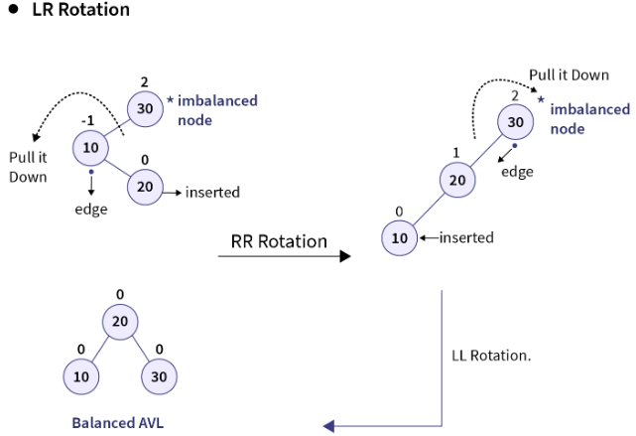
3. LR Rotation: So far, we have discussed that when the tree is heavy on one side, perform a single rotation in the opposite direction to counter the effect of tree skewness. But, there also exist some cases where a single tree rotation isn’t enough to balance the tree, i.e., we may need to perform one more rotation to counter the height-affecting operation’s effects finally.
One such case is of Left-Right (LR) insertion, i.e.; the tree gets unbalanced upon insertion of a node into the right subtree of the left child of the imbalance node. Let’s understand this case using an example:
Consider a situation where you create a BST using elements 30, 10, and 20. When the elements are inserted, element 30 becomes the root, 10 becomes its left child, and when element 20 is inserted, it is inserted as the right child of the node having the value 10. This causes an imbalance in the tree as the root node’s balance factor equals 2.
Now, as per the previous discussions, you may have noticed that a positive balance factor indicates that the given node is left-heavy, while a negative one indicates that the node is right-heavy. Now, if we notice the immediate parent of the inserted node, we notice that its balance factor is negative i.e., its right-heavy. Hence, you may say that we should perform a left rotation (RR rotation) on the immediate parent of the inserted node to counter this effect. Let’s perform this rotation and notice the change:
As you can observe, upon applying the RR rotation the BST becomes left-skewed and is still unbalanced. This is now the case of LL rotation and by rotating the tree along the edge of the imbalanced node in the clockwise direction, we can retrieve a balanced BST.
Hence, a simple rotation won’t fully balance the tree but it may flip the tree in such a manner that it gets converted into a single rotation scenario, after which we can balance the tree by performing one more tree rotation. This process of applying two rotations sequentially one after another is known as double rotation and since in our example the insertion was Left-Right (LR) insertion, this combination of RR and LL rotation is known as LR rotation. Hence, to summarize:
The LR rotation consists of 2 steps:
Apply RR Rotation (anti-clockwise rotation) on the left subtree of the imbalanced node as the left child of the imbalanced node is right-heavy. This process flips the tree and converts it into a left-skewed tree.
Perform LL Rotation (clock-wise rotation) on the imbalanced node to balance the left-skewed tree.
Hence, LR rotation is essentially a combination of RR and LL Rotation.

Slide 30
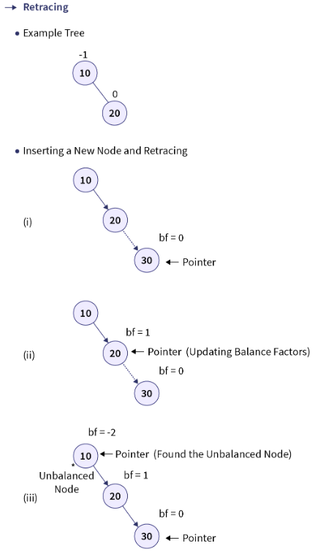
Operations on AVL Trees: Since AVL Trees are self-balancing Binary Search Trees, all the operations carried out using AVL Trees are similar to that of Binary Search Trees. Also, since searching an element and traversing the tree doesn’t change the tree’s structure, these operations can't violate the height balancing property of AVL Trees. Hence, searching and traversing operations are the same as that of Binary Search Trees.
However, upon the execution of each insertion or deletion operation, we check the balance factor of all the nodes and perform rotations to balance the AVL Tree if needed. Let's look at these operations in detail:
1. Insertion: In Binary Search Trees, the new node (let say N) was inserted in the tree by traversing it using BST logic to locate a node with NULL as its child that can be replaced to insert the new node N. Hence, in BSTs a new node is always inserted as a leaf node by replacing the NULL value of a node’s child.
Just like the insertion in BSTs, the new node is always inserted as a leaf node in AVL Trees i.e., the balance factor of the newly inserted node is always equal to 0. However, after each insertion in the tree, the balance factor for the ancestors of the newly inserted node is checked to verify that the tree is balanced or not. Here, only the ancestors of the inserted node are checked for imbalance because when a new node is inserted, it only alters the height of its ancestors, thereby inducing an imbalance in the tree. This process of finding the unbalanced node by traversing the ancestors of the newly inserted node is known as retracing. If the tree becomes unbalanced after inserting a new node, retracing helps us find the node’s location in the tree at which we need to perform the tree rotations to balance the tree.
The below gif demonstrates the retracing process upon inserting a new element in the AVL Tree:

Slide 31
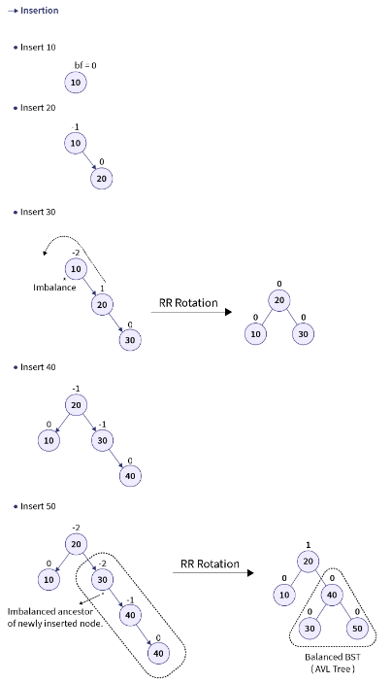
Let’s look at the algorithm of the insertion operation in AVL Trees:
Insertion in AVL Trees:
START
Insert the node using BST insertion logic.
Calculate and check the balance factor of each node.
If the balance factor follows the AVL criterion, go to step 6
Else, perform tree rotations according to the insertion done. Once the tree, is balanced go to step 6.
END
For better understanding, let’s consider an example where we wish to create an AVL Tree by inserting the elements: 10, 20, 30, 40, and 50. The below gif demonstrates how the given elements are inserted one by one in the AVL Tree:

Slide 32
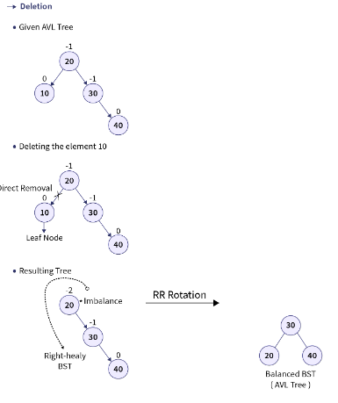
2. Deletion: When an element is to be deleted from a Binary Search Tree, the tree is searched using various comparisons via the BST rule till the currently traversed node has the same value as that of the specified element. Suppose the element is found in the tree. In that case, there are three different cases in which the deletion operation occurs depending upon whether the node to be deleted has any children or not:
Case 1: When the node to be deleted is a leaf node
In this case, the node to be deleted contains no subtrees, i.e., it’s a leaf node. Hence, it can be directly removed from the tree.
Case 2: When the node to be deleted has one subtree
In this case, the node to be deleted is replaced by its only child, thereby removing the specified node from the BST.
Case 3: When the node to be deleted has both subtrees.
In this case, the node to be deleted can be replaced by one of the two available nodes:
It can be replaced by the node having the largest value in the left subtree (Longest left node or Predecessor).
Or, it can be replaced by the node having the smallest value in the right subtree (Smallest right node or Successor).
Like the deletion operation in Binary Search Trees, the elements are deleted from AVL Trees depending on whether the node has any children. However, upon every deletion in AVL Trees, the balance factor is checked to verify whether the tree is balanced or not. If the tree becomes unbalanced after deletion, certain rotations are performed to balance the Tree.
Let’s look at the algorithm of the deletion operation in AVL Trees: Deletion in AVL Trees
START
Find the node in the tree. If the element is not found, go to step 7.
Delete the node using BST deletion logic.
Calculate and check the balance factor of each node.
If the balance factor follows the AVL criterion, go to step 7.
Else, perform tree rotations to balance the unbalanced nodes. Once the tree is balanced, go to step 7.
END
For better understanding, let’s consider an example where we wish to delete the element having value 10 from the AVL Tree created using the elements 10, 20, 30, and 40. The below gif demonstrates how we can delete an element from an AVL Tree:

Slide 33
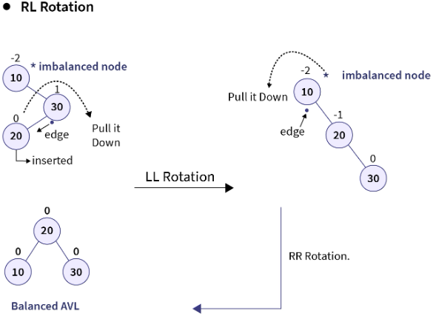
4. RL Rotation: It is similar to LR rotation but it is performed when the tree gets unbalanced, upon insertion of a node into the left subtree of the right child of the imbalance node i.e., upon Right-Left (RL) insertion instead of LR insertion. In this case, the immediate parent of the inserted node becomes left-heavy i.e., the LL rotation (right rotation or clockwise rotation) is performed that converts the tree into a right-skewed tree. After which, RR rotation (left rotation or anti-clockwise rotation) is applied around the edge of the imbalanced node to convert this right-skewed tree into a balanced BST. Let’s now observe an example of the RL rotation:
Hence, RL rotation consists of two steps:
Apply LL Rotation (clockwise rotation) on the right subtree of the imbalanced node as the right child of the imbalanced node is left-heavy. This process flips the tree and converts it into a right-skewed tree.
Perform RR Rotation (anti-clockwise rotation) on the imbalanced node to balance the right-skewed tree.
NOTE:
Rotations are done only on three nodes (including the imbalanced node) irrespective of the size of the Binary Search Tree. Hence, in the case of a large tree always focus on the two nodes around the imbalanced node and perform the tree rotations.
Upon insertion of a new node, if multiple nodes get imbalanced then traverse the ancestors of the inserted node in the tree and perform rotations on the first occurred imbalanced node. Continue this process until the whole tree is balanced. This process is knowns as retracing which is discussed later in the article.
Highlights:
Rotations are performed to maintain the AVL Balance criteria.
Rotation is a process of changing the structure without affecting the elements' order.
Rotations are done on an unbalanced node based on the location of the newly inserted node.
Single rotations include LL (clockwise) and RR (anti-clockwise) rotations.
Double rotations include LR (RR + LL) and RL (LL + RR) rotations.
Rotations are done only on 3 nodes, including the unbalanced node.
In the above example, we can observe that the tree's root node becomes imbalanced upon insertion of the node with the value 20. Since this is a type of RL insertion, we will perform LL rotation on the immediate parent of the inserted node thereby retrieving a right-skewed tree. Finally, we will perform RR Rotation around the edge of the imbalanced node (in this case the root node) to get the balanced AVL tree.

Slide 34
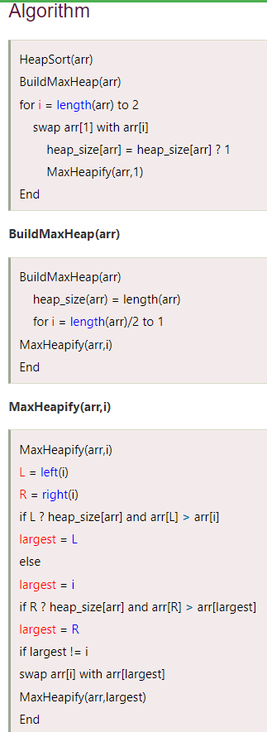
Heap Sort Algorithm
What is heap sort?
Heapsort is a popular and efficient sorting algorithm. The concept of heap sort is to eliminate the elements one by one from the heap part of the list and then insert them into the sorted part of the list.
Heapsort is the in-place sorting algorithm.
Now, let's see the algorithm of heap sort.
Working of Heap sort Algorithm: Now, let's see the working of the Heapsort Algorithm.
In heap sorting, there are two phases involved in the sorting of elements. By using the heap sort algorithm, they are as follows –
The first step includes the creation of a heap by adjusting the elements of the array.
After the creation of the heap, now remove the root element of the heap repeatedly by shifting it to the end of the array and then store the heap structure with the remaining elements.
In this session, we will discuss the Heapsort Algorithm.
Heap sort processes the elements by creating the min-heap or max-heap using the elements of the given array.
Min-heap or max-heap represents the ordering of the array in which the root element represents the minimum or maximum element of the array.
Heap sort recursively performs two main operations –
Build a heap H using the elements of the array.
Repeatedly delete the root element of the heap formed in 1st phase.
Before knowing more about the heap sort, let's first see a brief description of Heap.
What is a heap?
A heap is a complete binary tree, and the binary tree is a tree in which the node can have the utmost two children. A complete binary tree is a tree in which all the levels except the last level, i.e., leaf node, should be filled, and all the nodes should be left-justified.

Slide 35

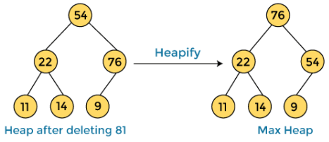
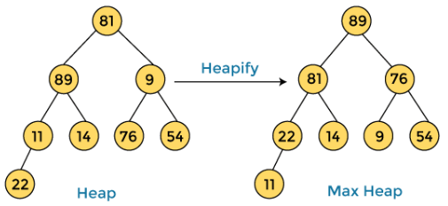


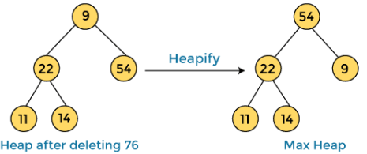
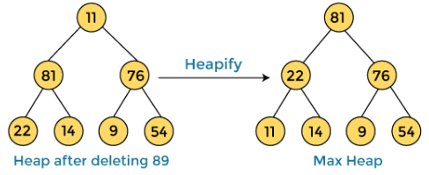


Now let's see the working of heap sort in detail by using an example. To understand it more clearly, let's take an unsorted array and try to sort it using heap sort. It will make the explanation clearer and easier.
First, we have to construct a heap from the given array and convert it into a max heap.
After converting the given heap into a max heap, the array elements are –
Next, we must delete the root element (89) from the max heap. To delete this node, we have to swap it with the last node, i.e. (11). After deleting the root element, we must heapify it to convert it into a max heap.
After swapping the array element 89 with 11, and converting the heap into max-heap, the elements of array are –
In the next step, we must again delete the root element (81) from the max heap. To delete this node, we have to swap it with the last node, i.e. (54). After deleting the root element, we again have to heapify it to convert it into max heap.
After swapping the array element 81 with 54 and converting the heap into max-heap, the elements of array are –
In the next step, we have to delete the root element (76) from the max heap again. To delete this node, we have to swap it with the last node, i.e. (9). After deleting the root element, we again have to heapify it to convert it into max heap.
After swapping the array element 76 with 9 and converting the heap into max-heap, the elements of array are -

Slide 36
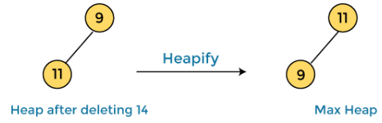
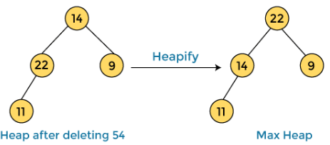



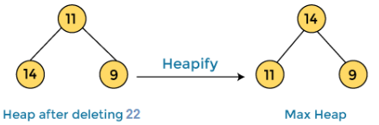




In the next step, again we have to delete the root element (54) from the max heap. To delete this node, we have to swap it with the last node, i.e. (14). After deleting the root element, we again have to heapify it to convert it into max heap.
After swapping the array element 54 with 14 and converting the heap into max-heap, the elements of array are –
In the next step, again we have to delete the root element (22) from the max heap. To delete this node, we have to swap it with the last node, i.e. (11). After deleting the root element, we again have to heapify it to convert it into max heap.
After swapping the array element 22 with 11 and converting the heap into max-heap, the elements of array are -
In the next step, again we have to delete the root element (14) from the max heap. To delete this node, we have to swap it with the last node, i.e. (9). After deleting the root element, we again have to heapify it to convert it into max heap.
After swapping the array element 14 with 9 and converting the heap into max-heap, the elements of array are –
In the next step, again we have to delete the root element (11) from the max heap. To delete this node, we have to swap it with the last node, i.e. (9). After deleting the root element, we again have to heapify it to convert it into max heap.
After swapping the array element 11 with 9, the elements of array are –
Now, heap has only one element left. After deleting it, heap will be empty.
After completion of sorting, the array elements are –
Now, the array is completely sorted.

Slide 37


Slide 38
#include <stdio.h>
/* function to heapify a subtree. Here 'i' is the index of root node in array a[], and 'n' is the size of heap. */
void heapify(int a[], int n, int i)
{
int largest = i; // Initialize largest as root
int left = 2 * i + 1; // left child
int right = 2 * i + 2; // right child
// If left child is larger than root
if (left < n && a[left] > a[largest])
largest = left;
// If right child is larger than root
if (right < n && a[right] > a[largest])
largest = right;
// If root is not largest
if (largest != i) {
// swap a[i] with a[largest]
int temp = a[i];
a[i] = a[largest];
a[largest] = temp;
heapify(a, n, largest);
}
}
/*Function to implement the heap sort*/
void heapSort(int a[], int n)
{
for (int i = n / 2 - 1; i >= 0; i--)
heapify(a, n, i);
// One by one extract an element from heap
for (int i = n - 1; i >= 0; i--) {
/* Move current root element to end*/
// swap a[0] with a[i]
int temp = a[0];
a[0] = a[i];
a[i] = temp;
heapify(a, i, 0);
}
}
/* function to print the array elements */
void printArr(int arr[], int n)
{
for (int i = 0; i < n; ++i)
{
printf("%d", arr[i]);
printf(" ");
}
}
int main()
{
int a[] = {48, 10, 23, 43, 28, 26, 1};
int n = sizeof(a) / sizeof(a[0]);
printf("Before sorting array elements are - \n");
printArr(a, n);
heapSort(a, n);
printf("\nAfter sorting array elements are - \n");
printArr(a, n);
return 0;
}

